Slide 1

Presentation Structure for Video Aid: Predicting Remaining Useful Life of Digital Twin Engines
Comprehensive overview of deep learning project stages
Notes:
AI-generated content may be incorrect. --- This presentation provides a comprehensive overview of our project on predicting the Remaining Useful Life (RUL) of digital twin engines using deep learning techniques. We will cover the project's motivation, objectives, technical background, methodology, dataset insights, model performance, diagnostics, and key findings. Image source: Microsoft 365 content library

Slide 2
Agenda Items
Project Overview and Motivation
Problem Definition and Objectives
Technical Background: Digital Twins, PHM, and RUL
Approach and Methodology
Dataset Exploration and Preprocessing Insights
Model Performance and Comparative Analysis
Diagnostic and Error Analysis
Limitations, Threats to Validity, and Key Findings
Notes:
--- We will begin with the project overview and motivation, followed by problem definition and objectives. Then, we explore the technical background, approach, and dataset preprocessing. Next, model performance and diagnostics are discussed, concluding with limitations and key findings. Image source: Microsoft 365 content library

Slide 3
Project Overview and Motivation
Notes:
--- This slide references information from the following file: https://safrangroup-my.sharepoint.com/personal/mamadou_bah_safrangroup_com/_layouts/15/Doc.aspx?sourcedoc=%7B9F312128-DBF1-4C14-B43A-BA71190E981E%7D&file=Msc%20Project%20Report.docx&action=default&mobileredirect=true&DefaultItemOpen=1 Aviation Industry Context and Maintenance Challenges, Project Aim: Deep Learning for RUL Prediction Using Digital Twins

Slide 4

Aviation Industry Context and Maintenance Challenges
Economic Impact of Aviation
Global aviation supports over 40 million flights annually and contributes more than USD 3.5 trillion to the global GDP.
Aircraft Utilization
Airbus A320s operate up to six flight cycles daily, carrying 150–180 passengers, influencing operational costs and revenues.
Maintenance Challenges
Unplanned downtime due to engine failures causes significant financial losses and disrupts flight schedules.
Shift to Predictive Maintenance
Predictive solutions are required to forecast failures and reduce disruptive unplanned maintenance in aviation.
Notes:
--- This slide references information from the following file: https://safrangroup-my.sharepoint.com/personal/mamadou_bah_safrangroup_com/_layouts/15/Doc.aspx?sourcedoc=%7B9F312128-DBF1-4C14-B43A-BA71190E981E%7D&file=Msc%20Project%20Report.docx&action=default&mobileredirect=true&DefaultItemOpen=1 The aviation industry is one of the most complex and economically significant sectors in the world. As of July 2025, global commercial aviation supports more than 40 million flights annually, transporting over 4.7 billion passengers and contributing more than USD 3.5 trillion to global GDP (IATA, 2025). In Europe alone, the industry accounts for more than 11 million jobs and EUR 823 billion in economic activity (Airbus, 2024). Aircraft such as the Airbus A320 family, widely deployed on short- to medium-haul routes between the UK, France, Spain, and other European countries, can typically perform up to six flight cycles per day depending on scheduling and turnaround times (Airbus, 2023). A single A320 aircraft carries approximately 150–180 passengers, and the operational costs and revenues generated from these flights scale significantly with fleet utilisation. Given the capital-intensive nature of aviation, unplanned aircraft downtime due to engine failures or unexpected maintenance events can cause substantial financial losses. A grounded aircraft not only results in direct repair costs but also leads to revenue loss from cancelled flights, disrupted schedules, and passenger compensation obligations (ICAO, 2022). While regulatory frameworks mandate strict maintenance, repair, and overhaul (MRO) intervals to ensure safety, unexpected faults still occur between scheduled maintenance checks. This creates an urgent need for predictive maintenance solutions that can accurately forecast when an engine component is likely to fail. Historically, maintenance strategies have shifted dramatically. In the 19th century, railway companies pioneered systematic inspections at fixed intervals (Aldrich, 2010). The aviation industry adopted similar principles, relying on reactive or calendar-based maintenance cycles. While these approaches offered clear benefits, they also left room for in-service failures. This highlights a crucial gap that needs to be addressed: ultimately, unplanned maintenance is always disruptive, and closing this gap is both a challenge and an opportunity to improve reliability and efficiency. Image source: Microsoft 365 content library

Slide 5
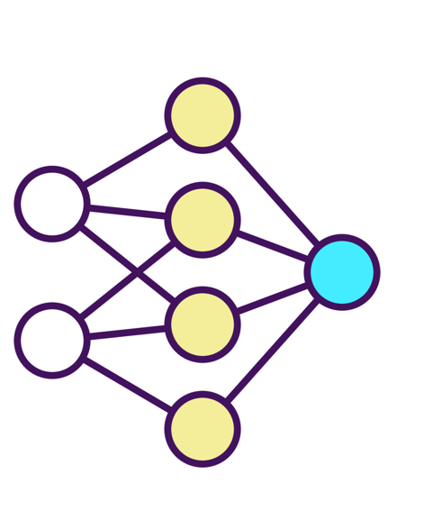
Project Aim: Deep Learning for RUL Prediction Using Digital Twins
RUL Prediction Importance
Predicting Remaining Useful Life helps reduce unplanned maintenance and operational disruptions in aviation.
C-MAPSS Dataset Usage
The NASA C-MAPSS dataset provides multivariate time-series run-to-failure data for turbofan engines.
Deep Learning Models Applied
CNNs extract spatial features while LSTMs capture temporal dependencies for RUL prediction.
Digital Twin Integration
Digital twins combine real-time sensor data and predictive models to enable proactive maintenance decisions.
Notes:
--- This slide references information from the following file: https://safrangroup-my.sharepoint.com/personal/mamadou_bah_safrangroup_com/_layouts/15/Doc.aspx?sourcedoc=%7B9F312128-DBF1-4C14-B43A-BA71190E981E%7D&file=Msc%20Project%20Report.docx&action=default&mobileredirect=true&DefaultItemOpen=1 Predicting the Remaining Useful Life (RUL) of critical components such as turbofan engines can save millions for airlines by reducing unplanned maintenance, minimising operational disruptions, and optimising maintenance planning. Data-driven prognostics is particularly promising in this context. NASA’s C-MAPSS dataset, generated through the simulation of a 90,000 lb thrust-class commercial turbofan engine, has become a benchmark for RUL research. It provides run-to-failure multivariate time-series data across multiple operating conditions and fault modes (Saxena et al., 2008; Saxena et al., 2008a). These datasets enable researchers to design, train, and evaluate machine learning and deep learning algorithms for predictive maintenance in aviation. This project leverages the C-MAPSS dataset to investigate the effectiveness of deep learning models, specifically Convolutional Neural Networks (CNNs) and Long Short-Term Memory (LSTM) networks, in predicting RUL. CNNs excel in extracting spatial patterns from sensor data, while LSTMs are designed to capture long-term temporal dependencies, making them highly suitable for time-series analysis. By comparing their performance in terms of prediction accuracy and generalisation across different engine conditions, this research aims to assess which model is better suited for integration within aviation digital twin systems. Importantly, while several studies have applied deep learning to the C-MAPSS dataset, many have struggled with generalisability across operating conditions or with balancing early and late prediction errors (Saxena et al., 2008a). This project addresses that gap by applying both CNN and LSTM models systematically across multiple datasets and explicitly evaluating trade-offs in predictive accuracy, robustness, and business applicability. A Digital Twin (DT) is a virtual replica of a physical system that mirrors its real-world behaviour through continuous data updates. When applied to aircraft engines, DTs can combine live sensor data with predictive models to estimate RUL in real time, thereby enabling proactive maintenance decision-making. In practice, this allows airlines to answer critical operational questions, such as: Will the engine remain healthy until the next scheduled overhaul? If not, operators can reschedule flights, reassign aircraft, or initiate earlier maintenance to prevent costly unscheduled downtime. Through this project, the benefits of data-driven prognostics will be demonstrated by evaluating CNN and LSTM models using C-MAPSS engine sensor data. In my own reflection, I see this work not just as a technical comparison, but as me taking a direct stab at a real challenge faced by the aviation industry. Having worked with forecasting in aerospace supply chains, I am motivated to explore whether these models can genuinely help airlines make more scientific and confident decisions about engine health. Beyond identifying the most effective approach, this work contributes an additional tool to the aviation industry’s predictive maintenance toolkit, helping airlines enhance efficiency, reduce costs, and ensure operational continuity. Image source: Microsoft 365 content library

Slide 6
Problem Definition and Objectives
Notes:
--- This slide references information from the following file: https://safrangroup-my.sharepoint.com/personal/mamadou_bah_safrangroup_com/_layouts/15/Doc.aspx?sourcedoc=%7B9F312128-DBF1-4C14-B43A-BA71190E981E%7D&file=Msc%20Project%20Report.docx&action=default&mobileredirect=true&DefaultItemOpen=1 Central Challenge and Dataset Benchmark, Project Aim and Key Objectives

Slide 7
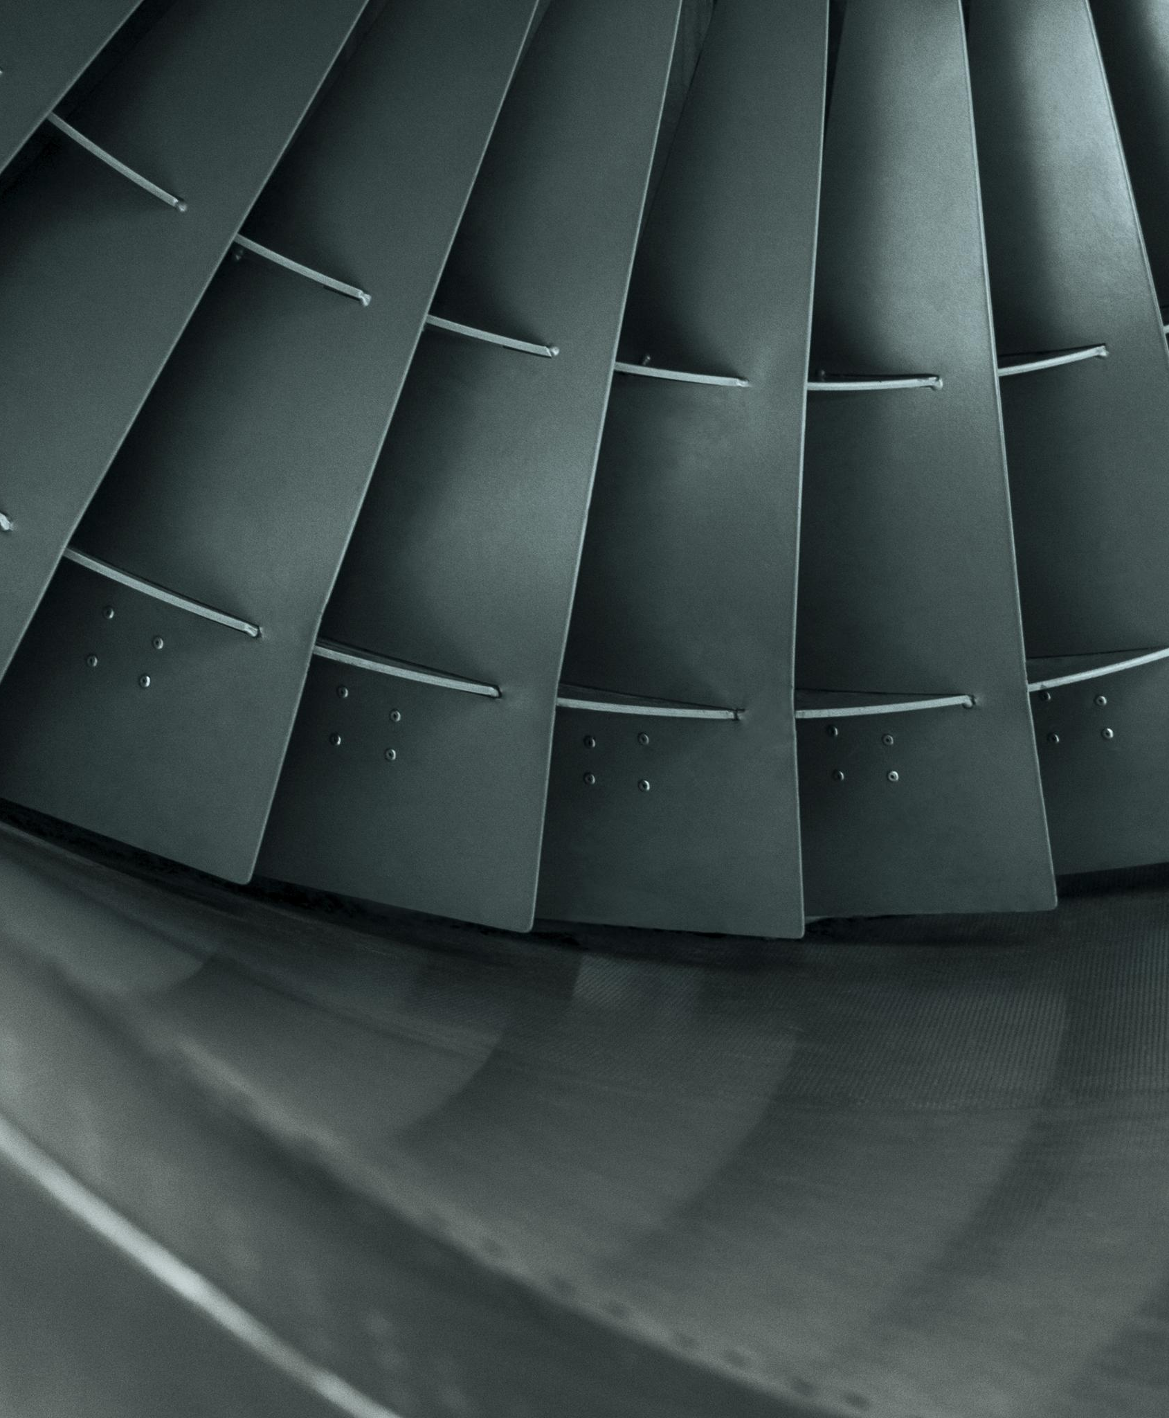
Central Challenge and Dataset Benchmark
Central Prediction Challenge
The main challenge is accurately predicting remaining operational cycles before failure with confidence.
Deep Learning Approaches
The project compares CNN and LSTM models to enhance prediction accuracy for remaining useful life.
NASA C-MAPSS Dataset
The C-MAPSS dataset simulates engine degradation with varied conditions, serving as a key benchmark.
Notes:
--- This slide references information from the following file: https://safrangroup-my.sharepoint.com/personal/mamadou_bah_safrangroup_com/_layouts/15/Doc.aspx?sourcedoc=%7B9F312128-DBF1-4C14-B43A-BA71190E981E%7D&file=Msc%20Project%20Report.docx&action=default&mobileredirect=true&DefaultItemOpen=1 Different methodologies for predicting failure exist, yet the central challenge remains the same: to determine, with confidence, how many operational cycles remain before failure occurs. This project focuses on applying deep learning, comparing Convolutional Neural Networks (CNN) and Long Short-Term Memory networks (LSTM), by building models to predict RUL. NASA’s C-MAPSS turbofan engine dataset (developed for the PHM’08 competition) provides a robust benchmark for this task. It simulates realistic engine degradation under varied operating conditions, fault modes, and sensor noise, offering an ideal environment to test prognostic methods (Saxena et al., 2008). Image source: Microsoft 365 content library

Slide 8

Project Aim and Key Objectives
Research Focus
Investigate deep learning models to predict Remaining Useful Life of machinery using Digital Twin and NASA datasets.
Literature and Techniques Review
Conduct a literature review on Digital Twin in predictive maintenance and analyse deep learning RUL prediction methods.
Model Development and Evaluation
Develop deep learning models and evaluate using performance metrics like RMSE and MAE on C-MAPSS datasets.
Industrial Impact Assessment
Assess implications for aviation industry and predictive maintenance improvement through model comparisons.
Notes:
--- This slide references information from the following file: https://safrangroup-my.sharepoint.com/personal/mamadou_bah_safrangroup_com/_layouts/15/Doc.aspx?sourcedoc=%7B9F312128-DBF1-4C14-B43A-BA71190E981E%7D&file=Msc%20Project%20Report.docx&action=default&mobileredirect=true&DefaultItemOpen=1 To investigate and evaluate deep learning models for predicting the Remaining Useful Life (RUL) of industrial machinery using Digital Twin technology and the NASA C-MAPSS dataset. 1. Conduct a literature review on Digital Twin applications in predictive maintenance 2. Analyse existing RUL prediction techniques with emphasis on deep learning 3. Develop relevant models for analysis 4. Evaluate models using performance metrics such as RMSE and MAE 5. Compare results across multiple C-MAPSS datasets (FD001–FD004). 6. Assess industrial implications for aviation and predictive maintenance. Image source: Microsoft 365 content library

Slide 9

Technical Background: Digital Twins, PHM, and RUL
Notes:
--- This slide references information from the following file: https://safrangroup-my.sharepoint.com/personal/mamadou_bah_safrangroup_com/_layouts/15/Doc.aspx?sourcedoc=%7B9F312128-DBF1-4C14-B43A-BA71190E981E%7D&file=Msc%20Project%20Report.docx&action=default&mobileredirect=true&DefaultItemOpen=1 Digital Twin Concept and Industry Relevance, Prognostics and Health Management (PHM) Functions and Evolution, Defining Remaining Useful Life (RUL) and Its Importance

Slide 10

Prognostics and Health Management (PHM) Functions and Evolution
PHM Core Functions
PHM includes sensing, feature extraction, health assessment, prognostics, decision support, and system adaptation.
Foundation in Condition-Based Maintenance
PHM evolved from Condition-Based Maintenance, incorporating sensor data for real-time condition monitoring.
Technological Advancements
Advances in AI, big data, and cloud computing accelerated PHM adoption and improved RUL predictions.
Industry Standards and Integration
PHM standards developed by SAE and IEEE fostered consistency and integration with Industry 4.0 technologies.
Notes:
--- This slide references information from the following file: https://safrangroup-my.sharepoint.com/personal/mamadou_bah_safrangroup_com/_layouts/15/Doc.aspx?sourcedoc=%7B9F312128-DBF1-4C14-B43A-BA71190E981E%7D&file=Msc%20Project%20Report.docx&action=default&mobileredirect=true&DefaultItemOpen=1 Prognostics and Health Management (PHM) is a data-driven and model-based approach designed to monitor, assess, and predict the health condition of an asset or system. The primary goal of PHM is to detect early signs of failure, estimate Remaining Useful Life (RUL), and support decision-making for maintenance and operations. By leveraging sensor data, machine learning, and physics-based models, PHM helps organisations implement predictive maintenance (Pd.M.), thereby minimising downtime, reducing costs, and improving safety (Kalgren et al., 2007). · PHM typically consists of six key functions: o Sensing and Data Acquisition – Collecting real-time operational data from sensors. o Feature Extraction – Identifying meaningful indicators of degradation. o Health Assessment – Evaluating the current condition of the system. o Prognostics – Predicting future states and estimating RUL. o Decision Support – Providing recommendations for maintenance and operations. o System Adaptation – Refining the PHM model based on new data (Vachtsevanos et al., 2006). It is fascinating to see how PHM evolved by integrating traditional maintenance strategies with emerging technologies. Condition-Based Maintenance (CBM), which has been in practice for over 60 years, laid the foundation for PHM. Early discussions on incorporating sensor data into CBM techniques can be traced back to Hess et al. (2003). These discussions emphasised the need for real-time data collection to enhance predictive maintenance capabilities. From the 2000’s onward, rapid advancements in computing power have further accelerated the adoption of PHM. Industries have leveraged big data analytics, artificial intelligence, and cloud computing to refine maintenance strategies and optimise Remaining Useful Life (RUL) predictions. Additionally, this period marked the rise of industry standards, signalling the field’s growing maturity. Organisations like SAE International and IEEE (ISO 13374, 2012) played a crucial role in developing PHM standards, ensuring consistency and widespread adoption across industries. Researchers such as Lee et al. (2014) have further highlighted how PHM integrates with Industry 4.0, digital twins, and real-time monitoring to improve asset reliability and performance. The continuous evolution of PHM demonstrates its growing importance in predictive maintenance and asset management, driven by technological advancements and industry-wide collaboration. Image source: Microsoft 365 content library

Slide 11
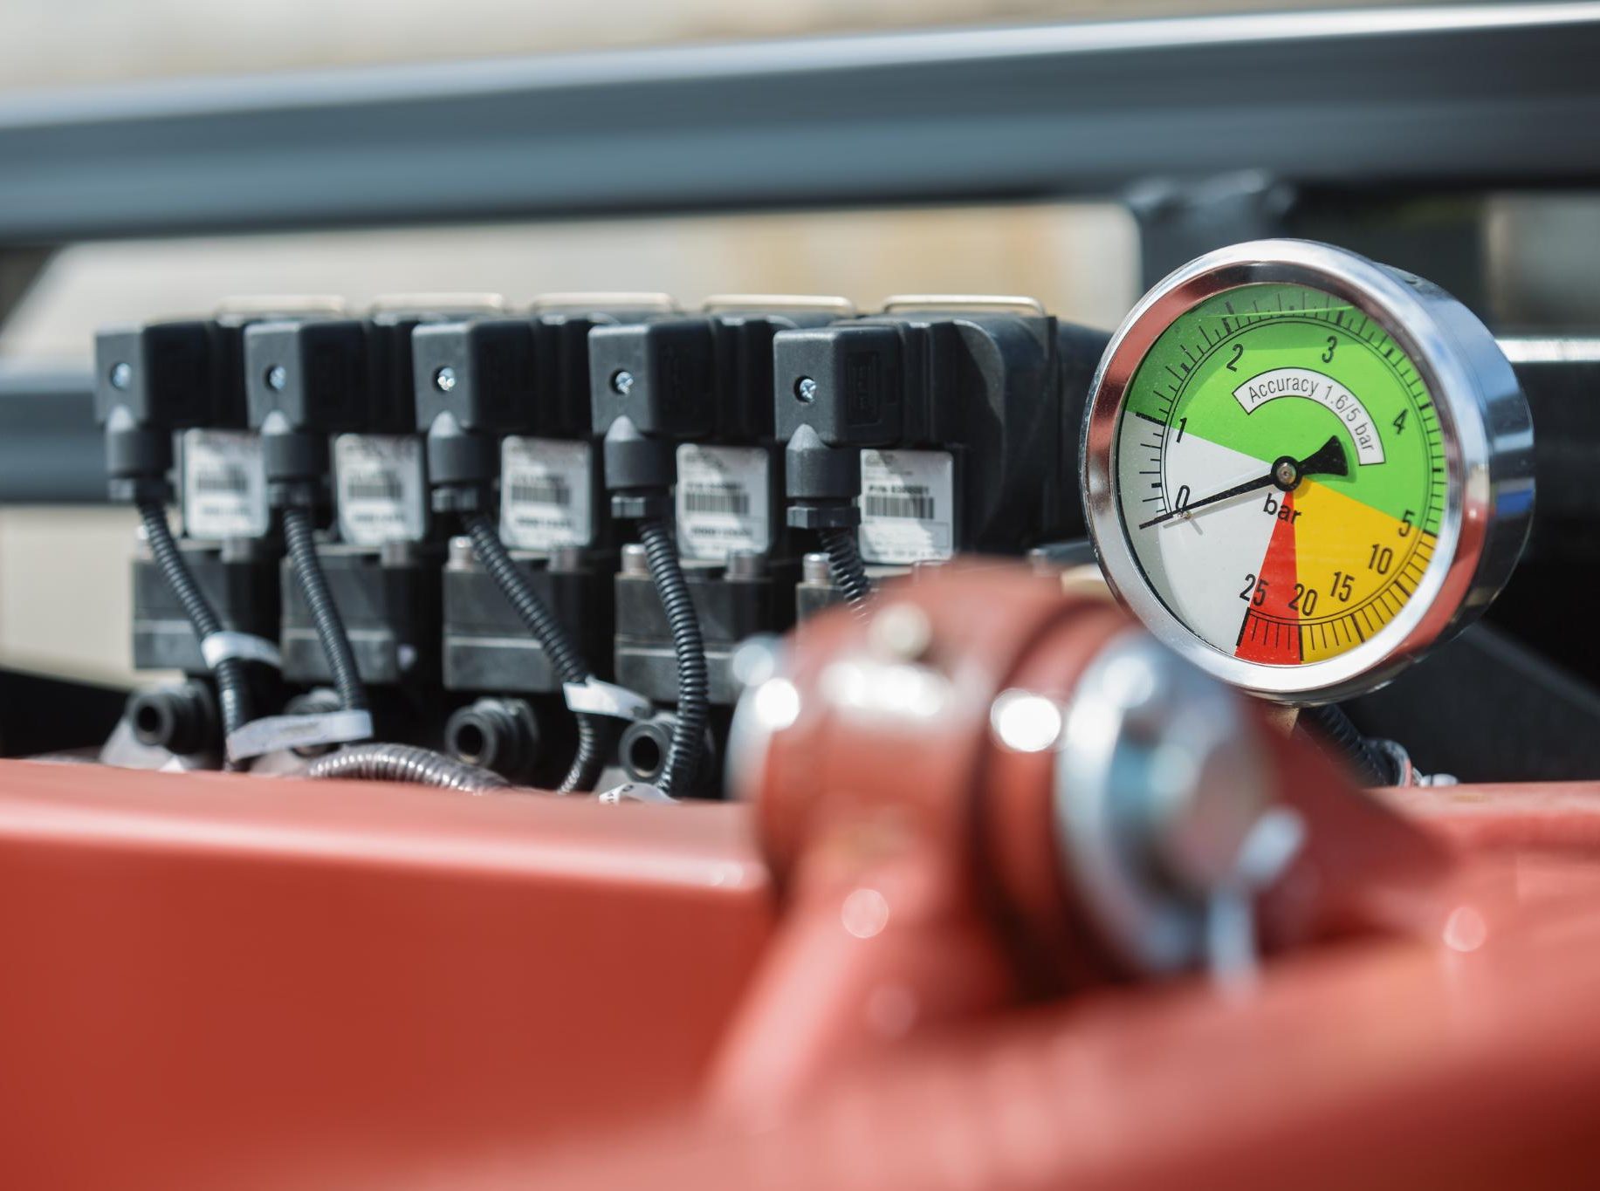
Defining Remaining Useful Life (RUL) and Its Importance
Understanding RUL Concept
Remaining Useful Life estimates how long an asset can operate before failure or replacement is needed.
Economic vs Engineering Perspectives
RUL varies by context, balancing operational efficiency, cost, and engineering reliability considerations.
Evolution of Maintenance Strategies
Traditional fixed schedules proved inefficient, leading to predictive maintenance and PHM approaches.
PHM and Industry 4.0
Prognostics and Health Management integrates predictive techniques to optimize maintenance and reduce failures.
Notes:
--- This slide references information from the following file: https://safrangroup-my.sharepoint.com/personal/mamadou_bah_safrangroup_com/_layouts/15/Doc.aspx?sourcedoc=%7B9F312128-DBF1-4C14-B43A-BA71190E981E%7D&file=Msc%20Project%20Report.docx&action=default&mobileredirect=true&DefaultItemOpen=1 My project focuses on exploring which algorithms or machine learning techniques are most effective in predicting Remaining Useful Life (RUL). Additionally, I aim to present and explain these concepts as I progress, using strong visual aids to enhance clarity. However, before diving into specific methodologies, it is essential to establish what exactly is meant by Remaining Useful Life, as this concept can have multiple interpretations. For instance, an aircraft engine under inspection may have a projected operational lifespan of another year, but economic considerations might dictate an earlier replacement to optimise operational efficiency and cost-effectiveness (Wu et al., 2024). In contrast, some components are designed to be used until complete failure, maximising their full operational life. This variability in RUL application highlights the importance of defining it in context, ensuring its calculation aligns with both engineering reliability and economic feasibility (Thakkar & Chaoui, 2021). Remaining Useful Life (RUL) is the estimated time span an asset can continue to operate before failure or the need for replacement occurs (Remaining Useful Life Prediction Based on Deep Learning: A Survey). RUL is a concept rooted in predictive maintenance and prognostics, aiming to strike a balance between preventing failures and scheduling maintenance or replacement without wasting useful service life. (Kalgren et al 2007) I have always found historical perspectives valuable in understanding concepts more clearly. As I explored the literature, it became evident that maintenance strategies originally followed fixed schedules like how cars in the UK require an MOT check annually, or how aviation regulators mandate overhauls every 10 years. However, these scheduled maintenance intervals did not guarantee the elimination of failures. A car can still break down between MOT periods, and an aircraft component might require replacement before or after an overhaul cycle. This inefficiency led to wasted resources, as failures could sometimes have been anticipated and addressed earlier. This needs to optimise maintenance intervals and reduce unnecessary costs led to the rise of Prognostics and Health Management (PHM) an approach inspired by the healthcare industry but widely applicable in Industry 4.0 and manufacturing. By the early 2000s, standards and research in PHM began to formalise the term Remaining Useful Life. For instance, Kalgren et al. (2007) introduced standardised PHM terminology, explicitly defining RUL as the predicted time to failure of a component. Image source: Microsoft 365 content library

Slide 12
Approach and Methodology
Notes:
--- This slide references information from the following file: https://safrangroup-my.sharepoint.com/personal/mamadou_bah_safrangroup_com/_layouts/15/Doc.aspx?sourcedoc=%7B9F312128-DBF1-4C14-B43A-BA71190E981E%7D&file=Msc%20Project%20Report.docx&action=default&mobileredirect=true&DefaultItemOpen=1 Dataset Selection and Preprocessing Steps, Model Development: Baseline, LSTM, CNN, and Hybrid, Evaluation Metrics and Framework

Slide 13
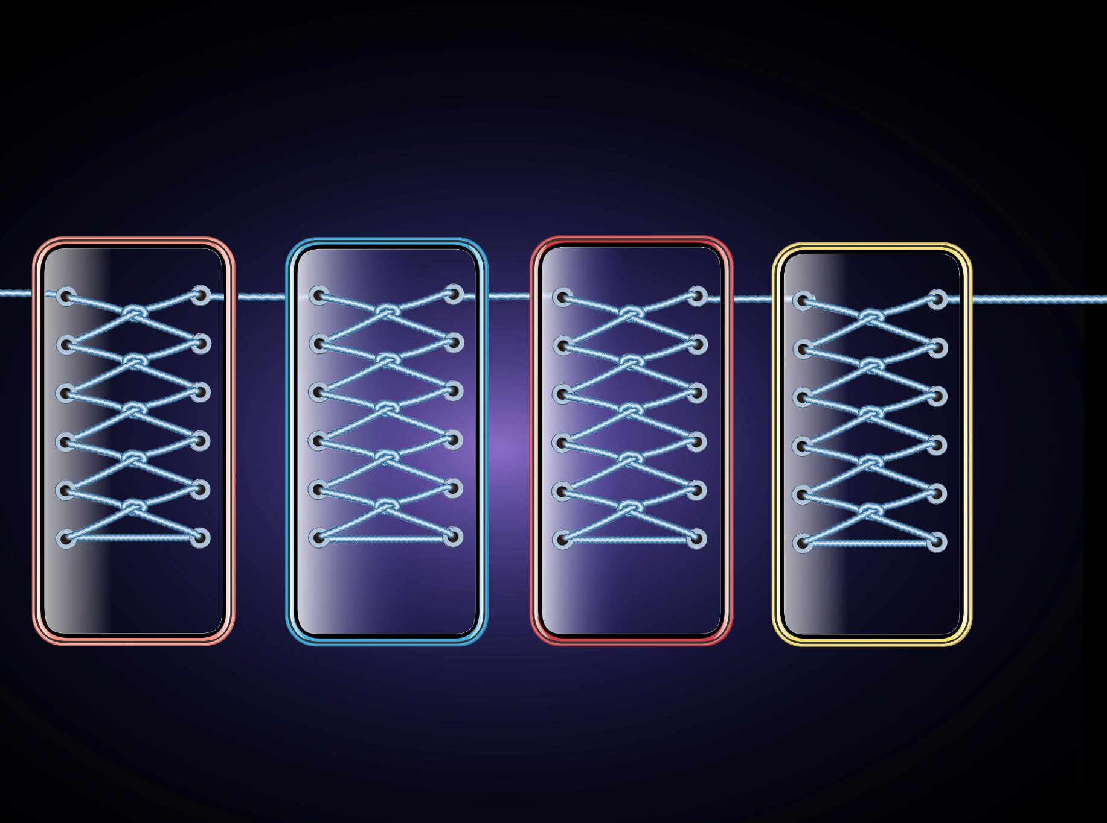
Preprocessing Steps
Dataset Overview
The dataset includes four C-MAPSS subsets with varied fault modes and operational conditions.
Sensor Data Preprocessing
Removed flat sensors with no variance and standardized sensor values per condition for fair comparison.
Remaining Useful Life Calculation
Calculated RUL as max cycle minus current, capped at 130 to focus on failure patterns near end of life.
Sliding Window and Data Split
Used sliding windows for fixed-length sequences and split data by unit to prevent leakage and overfitting.
Notes:
--- This slide references information from the following file: https://safrangroup-my.sharepoint.com/personal/mamadou_bah_safrangroup_com/_layouts/15/Doc.aspx?sourcedoc=%7B9F312128-DBF1-4C14-B43A-BA71190E981E%7D&file=Msc%20Project%20Report.docx&action=default&mobileredirect=true&DefaultItemOpen=1 · Dataset: Four subsets (FD001–FD004) from the C-MAPSS simulator, covering different fault modes and operational conditions. · Preprocessing: Removal of flat sensors, feature scaling, standardisation per condition, calculation of RUL, and sliding window generation. 1. Flat sensor removal: Dropped sensors with no variance across cycles. 2. RUL calculation: Computed Remaining Useful Life as max cycle minus current cycle, capped at 130. Here we are training the model we want them to recorgnise the pattern close to the failure point, so that it knows what signals will signify failure or remaining life, there is an explicit action I have taken here that might result in future failure and that is failure pattern does not show on early sensor data, so the pattern before failure will not appear if a plane has thousands of cycles left, I had to limit this based on what I read on how to apply a good remaining useful life and also keeping in mind unfortunately the limitation of the hardware I possess. 3. Standardisation: Applied z-score normalisation per operating condition. In simple terms, this means re-scaling sensor values so that each has an average of 0 and a standard deviation of 1. Doing this per operating condition ensures that engines working under different settings can still be compared fairly, important step when I moved to FD002 to 4, as different conditions. (W3School – Scaling) Our sensor data will have different units of measure, there is temperature, maybe vibration, our sensor does not tell us the exact unit of measurement so by applying the normalisation or scaling we make sure it is all under the same structure and we pick up the right pattern and we do not pick up what we might not require, the w3school page on scale was very helpful in understanding this very well. 4. Sliding windows: Created were used to break the engine runs into fixed-length sequences (e.g., 30 cycles), giving the models consistent slices of recent history to learn from and ensuring enough samples for reliable training. 5. Train/validation split: Engines were divided by unit number to prevent data leakage across sets, don’t want the data for training and testing to be mixed as otherwise we have risk of overfitting. This ensured comparability across datasets while preserving time-series dependencies crucial for LSTM and CNN performance. Image source: Microsoft 365 content library

Slide 14
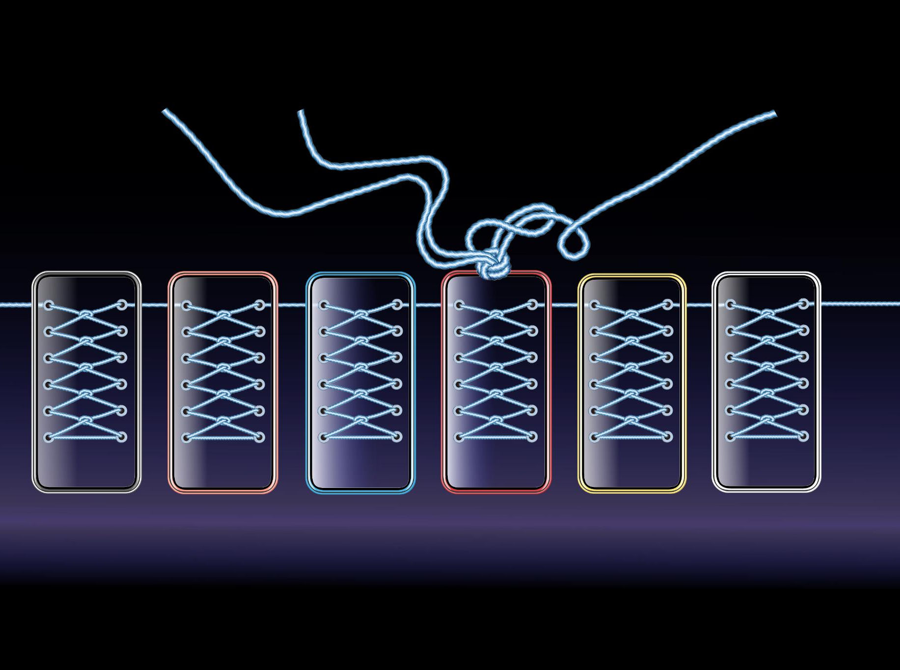
Model Development: Baseline, LSTM, CNN, and Hybrid
Baseline Linear Regression
A simple linear model offers an interpretable benchmark by fitting sensor features to remaining useful life.
LSTM Model for Temporal Patterns
LSTM captures temporal dependencies in sensor data to predict engine degradation over time.
CNN Model for Local Patterns
CNN extracts local signal patterns in sensor windows to identify degradation signatures efficiently.
Hybrid CNN-LSTM Approach
Combining CNN and LSTM leverages both local pattern detection and temporal memory for accurate predictions.
Notes:
--- This slide references information from the following file: https://safrangroup-my.sharepoint.com/personal/mamadou_bah_safrangroup_com/_layouts/15/Doc.aspx?sourcedoc=%7B9F312128-DBF1-4C14-B43A-BA71190E981E%7D&file=Msc%20Project%20Report.docx&action=default&mobileredirect=true&DefaultItemOpen=1 o Baseline Linear Regression as an interpretable benchmark for evaluating deep models and establishing performance baselines, I have discovered in my career as a demand planner, that when working with complex models, based to have a very simple model to offer perspective. o LSTM to capture temporal dependencies in sensor data o CNN to extract local patterns and degradation signatures o Hybrid CNN-LSTM combining strengths of both approaches Designing this section was the most fun and taught me a lot of what is currently going on in the global IT industry. To build a model, one must fix it into a file and use that to gain an output. Once trained, a model can operate in service, producing predictions. For now, my models are small, but with larger data (e.g., 10 million flights), accuracy could theoretically reach close to 99%. That is left for future exploration. A simple model that fits a straight line between sensor-derived features and the target RUL values. In practice, the linear regression model learns a set of weights that best approximate the relationship between engine condition (captured by feature vectors such as last-timestep, mean, or flattened sensor readings) and remaining useful life. For example, during training the model may learn that when a certain sensor pattern corresponds to about 50 cycles left, and when applied to new data it uses this learned mapping to estimate how many cycles remain. Although basic compared to deep learning, it provides a useful benchmark because it can still capture overall trends in degradation and give RUL predictions based on straightforward linear associations. LSTM Model Built to handle sequential data by remembering patterns over time, making them well-suited for engine degradation. In our implementation the first LSTM layer used 64 units and returned sequences, allowing the model to capture detailed temporal behaviour across cycles. A dropout layer (0.2) was added to reduce overfitting by randomly ignoring some connections during training. A second LSTM layer with 32 units condensed the information further, followed by another dropout for regularisation. Finally, a dense output layer with a single linear neuron produced the RUL prediction. The model was trained with the Adam optimiser and mean squared error loss, which are widely used defaults that balance efficiency and accuracy. We trained for 20 epochs with a batch size of 64, and included early stopping so training would stop if validation error stopped improving. For a layperson, the idea is that the LSTM builds a memory of how engines usually degrade: if during training it sees sensor patterns that usually mean 50 cycles remain, it remembers this association. Later, when the model sees a similar pattern in new sensor data, it can say “based on what I’ve learned, this engine has about 50 cycles left.” This design kept the model simple enough to train on available hardware, while still powerful enough to capture the temporal dependencies needed for RUL prediction. The model was trained with the Adam optimiser and mean squared error loss, which are widely used defaults that balance efficiency and accuracy. We trained for 20 epochs with a batch size of 64, and included early stopping so training would stop if validation error stopped improving. This design kept the model simple enough to train on available hardware, while still powerful enough to capture the temporal dependencies needed for RUL prediction. CNN Model Designed to detect localised patterns in sensor data across sliding windows. The model architecture used one-dimensional convolutional layers (64 filters with kernel size 5, then 128 filters with kernel size 3), each followed by max pooling to reduce sequence length while keeping the most important features. A global average pooling layer then compressed the sequence into a single representation. Dropout layers (0.2) were included to reduce overfitting, followed by a dense hidden layer (64 neurons with ReLU) and finally a linear output neuron predicting the RUL. The model was trained with Adam optimiser and MSE loss for up to 25 epochs with a batch size of 64, using early stopping if validation error stopped improving. In simple terms, the CNN works like a moving filter that scans across the 30-cycle window, picking out local signal patterns that often repeat as engines degrade. If during training it learns that a certain vibration or temperature pattern tends to show up around 50 cycles before failure, it can later recognise that pattern in new data and predict a similar RUL. CNN-LSTM Model built the CNN and the LSTM separately first. That made me curious: could combining them give me the best of both local pattern detection from CNNs and temporal memory from LSTMs while reducing each one’s weaknesses? The hybrid is my way of testing that idea. Even though this project compares CNN and LSTM directly, it’s only fair to also explore whether a simple, well-structured combination can do better. A two-stage model that first uses 1-D convolutions (64 filters, kernel 5; then 128 filters, kernel 3, each with batch normalisation, dropout 0.2, and max-pooling) to detect short, repeating degradation motifs, and then an LSTM (64) to model how those motifs evolve over the 30-cycle window. A small dense head (32 → 1, linear) outputs RUL. Trained with Adam (1e-3), MSE, batch 64, and early stopping (patience 4). In plain terms, the CNN finds the signal patterns; the LSTM understands their order together giving a more complete view of engine health. All models were implemented with modular, reusable code. While function-level code is not included in this section, the detailed implementations are preserved in appendices for reference. This keeps the methodology focused on the research process, while maintaining transparency. Image source: Microsoft 365 content library

Slide 15
Evaluation Metrics and Framework
Root Mean Squared Error (RMSE)
RMSE measures average prediction error, giving more weight to larger mistakes for safety-critical applications.
Mean Absolute Error (MAE)
MAE calculates average absolute errors treating all mistakes equally, providing easier interpretation.
Combined Metric Benefits
Using both RMSE and MAE offers balanced evaluation and highlights occasional large errors affecting model reliability.
Notes:
--- This slide references information from the following file: https://safrangroup-my.sharepoint.com/personal/mamadou_bah_safrangroup_com/_layouts/15/Doc.aspx?sourcedoc=%7B9F312128-DBF1-4C14-B43A-BA71190E981E%7D&file=Msc%20Project%20Report.docx&action=default&mobileredirect=true&DefaultItemOpen=1 Evaluation Framework RMSE is like asking, “on average, how far off are my predictions from the truth, giving more weight to larger mistakes?” It is the square root of the average of squared differences between predicted and actual values. Squaring emphasises large errors (a 20-cycle error counts four times more than a 10-cycle error). This is valuable in safety-critical contexts like aviation, where underestimating RUL by a large margin could have severe consequences. MAE (Mean Absolute Error) MAE tells us “On average, by how many cycles did we miss the mark?” It is the average of the absolute differences between predicted and actual values. Unlike RMSE, it treats all errors equally, without disproportionately penalising larger ones. This makes it easier to interpret but less sensitive to catastrophic failures. Why both? Using RMSE and MAE together gives a more balanced evaluation. If both values are low and close together, the model is consistently accurate. If RMSE is much higher than MAE, it signals that occasional large errors are dragging performance down critical insight when assessing whether a model is reliable for deployment. Image source: Microsoft 365 content library

Slide 16
Dataset Exploration and Preprocessing Insights
Notes:
--- This slide references information from the following file: https://safrangroup-my.sharepoint.com/personal/mamadou_bah_safrangroup_com/_layouts/15/Doc.aspx?sourcedoc=%7B9F312128-DBF1-4C14-B43A-BA71190E981E%7D&file=Msc%20Project%20Report.docx&action=default&mobileredirect=true&DefaultItemOpen=1 FD001–FD004: Dataset Characteristics and Implications, Preprocessing Strategies Across Datasets

Slide 17
FD001–FD004: Dataset Characteristics and Implications
FD001 Dataset Overview
FD001 features one operating regime and single degradation mode, making it a baseline for model testing.
FD002 Dataset Complexity
FD002 adds multiple operating conditions, increasing variability and making modeling more challenging.
FD003 Dual Fault Modes
FD003 introduces two fault modes under one condition, broadening lifespan range and complexity.
FD004 Combined Challenges
FD004 features multiple conditions and dual faults, offering the toughest benchmark for model robustness.
Notes:
--- This slide references information from the following file: https://safrangroup-my.sharepoint.com/personal/mamadou_bah_safrangroup_com/_layouts/15/Doc.aspx?sourcedoc=%7B9F312128-DBF1-4C14-B43A-BA71190E981E%7D&file=Msc%20Project%20Report.docx&action=default&mobileredirect=true&DefaultItemOpen=1 Context: FD001 contains one operating regime (sea level) and a single degradation mode (HPC). This makes it the least confounded split and an appropriate baseline for sanity–checking models before moving to multi‑condition or multi‑fault settings. Key Characteristics: Engine lifespans range from ~130 to ~360 cycles (mean ≈206, σ ≈46). The histogram is tightly clustered around 180–220 cycles, with a gentle right tail and a few long-life outliers past 300. In short: most engines fail near the 200-cycle mark, making FD001 a relatively homogeneous baseline. Figure A. Distribution of engine lifespans Looking at the RUL paths, I sampled four engines at random to see how life plays out in practice. Each follows the same pattern: capped at 130 early on, then dropping in a straight line to zero at failure. Figure B makes it clear how the dataset defines wear-out, and why modelling that steady decline is key. Figure B. Example RUL trajectories showing the 130‑cycle clip then linear decline to failure. The heatmap highlights clear sensor groupings (e.g., 2, 4, 8, 13, 15, 17) alongside others that move in the opposite direction (e.g., 12, 21). That mix gives both overlap and fresh signals to learn from. Since FD001 runs under one condition, we will simply drop the flat sensors and apply global z-scaling. Figure C. Sensor correlation heatmap highlighting key clusters. Implications: With no feature shift from changing conditions, models are expected to achieve their lowest errors on FD001. Sequence models (e.g., LSTM) should benefit from the smooth temporal progression of degradation, while CNNs can exploit local motifs; both serve as a yardstick for harder datasets. Context FD002 keeps the same single fault type as FD001 but introduces multiple operating conditions. That extra variability makes it a tougher benchmark and will forces the models to disentangle condition effects from true degradation. Key Characteristics Lifespans again range ~130–360 cycles (mean ≈207, σ ≈47). The distribution is centred around 190–210 cycles, but we see a wider tail than FD001. Figure D shows how more engines stretch out towards 300+ cycles. Figure D. Distribution of engine lifespans The same capped-then-linear pattern holds (MAX_RUL = 130 then decline). I picked four random engines: they confirm the dataset structure but with more spread across lifetimes (Figure E). Figure E. Example RUL trajectories showing the 130‑cycle clip then linear decline to failure. The correlation heatmap (Figure F) shows most sensors are strongly positive with each other, but we also see a few outliers (e.g., sensor 15 shows clear negative behaviour). With multiple operating conditions, we normalised per-condition instead of globally. Figure F. Sensor correlation heatmap highlighting key clusters. Implications FD002 is harder than FD001 because models must cope with condition-driven variation as well as wear. LSTMs are expected to generalise better here, as they can track degradation across regimes, while CNNs may struggle with the shifts. FD003 introduces dual fault modes while keeping a single operating condition. Compared to FD002, the absence of changing conditions removes regime shifts, but the presence of two simultaneous degradation paths makes the problem more complex. Key characteristics lifespans spread wider here, ~140–520 cycles (mean ≈247, σ ≈87). Figure G shows the histogram: some engines fail in ~150–200 cycles, while others run well past 400, creating a broader, more variable dataset than FD001/FD002. Figure G. Distribution of engine lifespans The same capped-then-linear behaviour is present. The four sampled engines (Figure H) illustrate how lifetimes differ widely, yet the drop pattern remains steady once degradation begins. Figure H. Example RUL trajectories showing the 130‑cycle clip then linear decline to failure. The correlation heatmap (Figure I) reveals clusters of strongly linked sensors but also more negative relationships than in FD001. This reflects the dual-fault nature: some signals move in opposite directions as different subsystems degrade. Figure I. Sensor correlation heatmap highlighting key clusters. Implications FD003 is a useful test of whether models can separate overlapping failure signatures. LSTMs are expected to shine by tracking temporal dependencies across both fault types, while simpler models may confuse the signal. FD004 is the hardest of the four sets: it combines multiple operating conditions with dual fault modes. This means models must handle both shifting regimes and overlapping degradation signatures. Key characteristics Lifespans run from ~140 up to ~530 cycles (mean ≈246, σ ≈73). Figure J shows a broad histogram with engines failing anywhere between 150 and 400+, making the distribution much wider than FD001 or FD002. Figure J. Distribution of engine lifespans As before, RUL is capped at 130 cycles then falls linearly to zero. The four random engines in Figure K show the same structural pattern but with very different overall lifetimes, from ~130 to beyond 500 cycles. Figure K. Example RUL trajectories showing the 130‑cycle clip then linear decline to failure. The heatmap (Figure L) shows strong clusters with some negative relationships (e.g., sensor 15). Figure L. Sensor correlation heatmap highlighting key clusters. Implications FD004 is the toughest benchmark: models are tested on their ability to generalise across conditions and fault types simultaneously. Performance here gives the clearest signal of robustness.

Slide 18
Preprocessing Strategies Across Datasets
Data Loading and Alignment
Raw data aligned with RUL labels and targets clipped at 130 cycles to stabilize early life influence.
Sensor Selection and Scaling
Flat sensors dropped based on training set; scaling applied globally or per condition based on dataset type.
Sliding Window Sequence Generation
Sequences of 30 cycles generated using sliding windows to create consistent inputs for model training.
Dataset Splitting and Leakage Prevention
Data split by engine unit to avoid train-validation-test leakage ensuring unbiased model evaluation.
Notes:
--- This slide references information from the following file: https://safrangroup-my.sharepoint.com/personal/mamadou_bah_safrangroup_com/_layouts/15/Doc.aspx?sourcedoc=%7B9F312128-DBF1-4C14-B43A-BA71190E981E%7D&file=Msc%20Project%20Report.docx&action=default&mobileredirect=true&DefaultItemOpen=1 The raw data was first loaded and aligned with its RUL labels. Targets were created using the MAX_RUL clipping of 130 cycles to reduce early-life dominance. We split by engine unit before scaling, ensuring no leakage between train/validation/test. Flat sensors (1, 5, 10, 16, 18, 19) were dropped using the training set only, then removed consistently from Val/test. A single Standard Scaler was fitted on the remaining train sensors and applied to all splits (since FD001 has one operating condition). Finally, sequences of length 30 cycles were generated for model input. After preprocessing, we retained 80 engines for training and 20 for validation, with X_train shaped (14241, 30, 15). The same general pipeline was followed as with FD001, but with one key difference: datasets with multiple operating conditions (FD002 and FD004) required scaling per condition. After calculating RUL with a maximum cap of 130 cycles, we split by engine unit to prevent leakage, dropped flat sensors identified from the training set, and built true RUL values for test units using the provided RUL files. For FD002 and FD004, condition keys were derived from operating settings and separate scalers were fitted per regime. For FD003, which has a single condition, a global scaler was applied as in FD001. Across all three datasets, once scaling was applied, sliding windows of 30 cycles were generated for model input, creating consistent train, validation, and test arrays. This ensured comparability across datasets while adapting appropriately to regime variability. · Sliding-window length (seq_len), input features used, target definition. · MAX_RUL clipping (130) reduces dominance of early life; stabilises learning. · Per-condition scaling for FD002/FD004; simple global scaling for FD001/FD003. Image source: Microsoft 365 content library

Slide 19
Model Performance and Comparative Analysis
Notes:
--- This slide references information from the following file: https://safrangroup-my.sharepoint.com/personal/mamadou_bah_safrangroup_com/_layouts/15/Doc.aspx?sourcedoc=%7B9F312128-DBF1-4C14-B43A-BA71190E981E%7D&file=Msc%20Project%20Report.docx&action=default&mobileredirect=true&DefaultItemOpen=1 Model Architectures and Training Summaries, Performance Results: RMSE, MAE, and Visual Summaries, Practical Implications for Aviation Maintenance

Slide 20
Model Architectures and Training Summaries
Linear Regression Baseline
A simple linear regression model flattens 30-cycle sequences to establish a performance baseline.
CNN for Local Patterns
CNN captures short-term temporal patterns using 1D convolutions and acts as a feature extractor.
LSTM for Long-Term Dependencies
LSTM models longer-term temporal dependencies, effectively learning trends over entire sequences.
Hybrid CNN-LSTM Model
Hybrid model combines CNN feature extraction with LSTM temporal modelling for robust sequence analysis.
Notes:
--- This slide references information from the following file: https://safrangroup-my.sharepoint.com/personal/mamadou_bah_safrangroup_com/_layouts/15/Doc.aspx?sourcedoc=%7B9F312128-DBF1-4C14-B43A-BA71190E981E%7D&file=Msc%20Project%20Report.docx&action=default&mobileredirect=true&DefaultItemOpen=1 As a benchmark, we used a very simple model: each 30-cycle sequence was flattened into a 2D vector (using the last time step as representative), and a standard linear regression was trained. This gave us a baseline expectation if deep learning models cannot significantly outperform this, their added complexity isn’t justified. Figure M: Baseline model (Linear Regression). CNN: The CNN was designed to pick up local temporal patterns in the sensor data. Using 1D convolutions across the time axis, the network captures short-term dependencies like sudden shifts in sensor readings. It was trained for 30 epochs with batch size 128, and early stopping ensured we did not overfit. The CNN effectively acts as a pattern recogniser, turning each input window into a set of learned feature maps. Figure N: CNN model LSTM: The LSTM was built to model longer-term dependencies in the degradation process. Unlike the CNN, which looks at short patches, the LSTM can keep track of trends across the entire 30-cycle window, remembering how degradation evolves over time. We trained for 50 epochs (batch size 128), allowing the model to converge steadily. The training logs show a gradual decrease in loss over many epochs, highlighting the LSTM’s strength in learning temporal dynamics. Figure O: LSTM model CNN–LSTM hybrid: The hybrid combines the strengths of both approaches: CNN layers first extract local temporal features, and the output is then passed into LSTM layers that capture the broader progression. In other words, the CNN acts as a feature extractor and the LSTM as a temporal modeller. This model was also trained for 50 epochs with batch size 128. By design, it should perform well on datasets like FD003/FD004 where both local sensor correlations and long-term temporal signals matter. Figure P: CNN–LSTM hybrid

Slide 21
Performance Results: RMSE, MAE, and Visual Summaries
Model Selection Overview
Four models were chosen: baseline linear regression, 1D CNN, LSTM, and CNN–LSTM hybrid representing standard RUL prediction approaches.
LSTM Performance Superiority
LSTM consistently ranked first across RMSE and MAE metrics on all datasets, showing clear superiority over other models.
Comparative Model Rankings
CNN and CNN–LSTM models alternated between second and third place depending on dataset complexity, baseline always last.
Visual Performance Summaries
Heatmaps and summary tables visually emphasise differences in RMSE and MAE, highlighting deep learning approach strengths and weaknesses.
Notes:
--- This slide references information from the following file: https://safrangroup-my.sharepoint.com/personal/mamadou_bah_safrangroup_com/_layouts/15/Doc.aspx?sourcedoc=%7B9F312128-DBF1-4C14-B43A-BA71190E981E%7D&file=Msc%20Project%20Report.docx&action=default&mobileredirect=true&DefaultItemOpen=1 We now turn to model performance. Based on our preprocessing design choices (e.g., clipping RUL at 130 cycles) and insights from the literature review, we selected a baseline linear regression, a 1D CNN, an LSTM, and a CNN–LSTM hybrid. These models represent industry standards in RUL prediction. The purpose here is not to iteratively optimise or redesign them, but to evaluate their relative strengths. Our aim is to identify which deep learning approach is most effective for this problem, leaving further tuning and extension for future work. Summary Plots & Table across FD001–FD004 Figure Q: Model ranking across datasets (RMSE and MAE). Across all datasets, the LSTM consistently ranked first by RMSE and MAE, showing clear superiority. The CNN and CNN–LSTM alternated between second and third place depending on dataset complexity, while the baseline was always last. This reinforces that temporal models are most robust, but CNNs and hybrids still provide meaningful competition. Figure R: Summary table of RMSE and MAE by dataset and model. The table confirms that LSTMs achieve the lowest RMSE and MAE on all four datasets, with their advantage most pronounced on FD003 and FD004. CNN–LSTM hybrids performed close to LSTMs but lagged slightly, while CNNs were competitive but more affected by condition shifts (FD002/FD004). The baseline regression showed the highest errors throughout, validating the need for deep learning approaches. Figure S: Heatmaps of RMSE and MAE (lower is better). The heatmaps visually highlight the LSTM’s dominance with the darkest green cells across datasets, especially FD003 (RMSE = 14.38, MAE = 9.33). CNN–LSTM appears consistently strong, but slightly weaker than pure LSTM, while CNN performs better on simpler datasets. The red blocks for the baseline emphasise its consistent underperformance relative to all deep models.

Slide 22
Practical Implications for Aviation Maintenance
Interpretation of RMSE in RUL
RMSE of about 18 cycles means predictions fall within ±19 cycles, offering a three-day scheduling buffer.
Cost Asymmetry of Errors
Early part replacement costs less than late failure risks, making conservative predictions safer in aviation.
Planner’s Operational Perspective
Predictive models support spare parts forecasting and workforce scheduling, enabling proactive maintenance planning.
Notes:
--- This slide references information from the following file: https://safrangroup-my.sharepoint.com/personal/mamadou_bah_safrangroup_com/_layouts/15/Doc.aspx?sourcedoc=%7B9F312128-DBF1-4C14-B43A-BA71190E981E%7D&file=Msc%20Project%20Report.docx&action=default&mobileredirect=true&DefaultItemOpen=1 RMSE can be interpreted directly in cycles of RUL. For instance, an RMSE of 18.6 implies the model is typically within ±19 cycles of the true failure point. Assuming an aircraft engine averages ~6 flight cycles per day, this corresponds to roughly three days of scheduling buffer, which is a meaningful planning horizon for inspections and spare-part logistics. For airline planners, such an error margin provides an actionable signal: even if the prediction is not perfect, it prompts human review and inspection of the affected engine. This early warning allows planners to adjust maintenance slots, staffing, and spare allocation in advance, reducing the risk of unplanned groundings. While integrating this process into day-to-day fleet operations can be complex, the predictive buffer is valuable as an indicator to trigger proactive checks and informed planning. MAE provides an estimate of the typical prediction error in cycles. For example, an MAE of 15 cycles means that most forecasts are within ±15 cycles of the actual RUL, corresponding to about 2–3 days of flight operations. While RMSE highlights the risk of large deviations, MAE gives planners a clearer sense of the day-to-day reliability of the predictions. The prediction errors in this study can be directly interpreted in cycles of remaining life. For example, an RMSE of 18–20 cycles equate to roughly three days of flight operations for a short-haul engine completing ~6 cycles per day. This buffer is operationally meaningful: it gives planners time to schedule inspections, order parts, and allocate maintenance slots in advance. Even though perfect accuracy is impossible, consistent early warning by even a few days can reduce costly unplanned groundings and improve overall fleet availability. Cost asymmetry in aviation. In aviation maintenance, the cost of error is not symmetric. An early prediction (replacing a part sooner than strictly necessary) carries some cost in labour and lost component life, but a late prediction (missing an impending failure) risks far greater costs flight disruption, safety concerns, and emergency replacements. The diagnostic analysis showed that models such as CNN and CNN–LSTM tend toward conservative under-prediction, which in practice provides a safer margin. While not optimal for maximising component usage, this bias is valuable in a safety-critical environment. Planner’s perspective. From a supply chain and planning standpoint, these models directly support forecasting demand for spares and scheduling workforce capacity. As someone already working in aviation planning, I see clear parallels: an error margin of ±15 cycles (≈2–3 days) is enough to adjust procurement timelines for critical spares, align with maintenance slots, and communicate with suppliers. While the C-MAPSS dataset is simulated, the principle is transferable predictive models can provide an evidence-based signal to planners, who can then layer human judgment and operational context on top. This strengthens proactive maintenance and reduces the reliance on reactive firefighting in the supply chain. Image source: Microsoft 365 content library

Slide 23
Diagnostic and Error Analysis
Notes:
--- This slide references information from the following file: https://safrangroup-my.sharepoint.com/personal/mamadou_bah_safrangroup_com/_layouts/15/Doc.aspx?sourcedoc=%7B9F312128-DBF1-4C14-B43A-BA71190E981E%7D&file=Msc%20Project%20Report.docx&action=default&mobileredirect=true&DefaultItemOpen=1 FD001 Baseline Model: Calibration, Residuals, and Variability, FD002 CNN Model: Calibration, Residuals, and Variability, FD003 LSTM Model: Calibration, Residuals, and Variability, FD004 Hybrid Model: Calibration, Residuals, and Variability

Slide 24
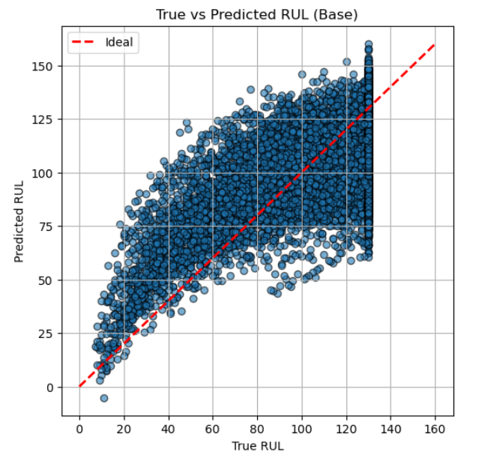
FD001 Baseline Model: Calibration, Residuals, and Variability
Calibration Bias in Predictions
Baseline model underestimates high RUL values and slightly overestimates low RUL, showing linear simplification limits.
Residual Error Distribution
Residuals show wide spread with a slight positive bias, indicating over-prediction near failure risk.
Per-Engine Prediction Variability
Significant engine-to-engine variability observed, baseline model lacks temporal memory to capture unique patterns.
Notes:
--- This slide references information from the following file: https://safrangroup-my.sharepoint.com/personal/mamadou_bah_safrangroup_com/_layouts/15/Doc.aspx?sourcedoc=%7B9F312128-DBF1-4C14-B43A-BA71190E981E%7D&file=Msc%20Project%20Report.docx&action=default&mobileredirect=true&DefaultItemOpen=1 The calibration scatter shows that the baseline linear regression systematically underestimates RUL at high values (flattening out near the 130-cycle cap) and overestimates slightly at very low RUL. The diagonal reference line highlights the gap: predictions fail to track the true decline into failure. This reflects the model’s linear simplification it cannot capture the curved degradation trajectory, only a rough average trend. Figure T: Calibration plot (True vs Pred, baseline FD001) Residual distributions & bias The residual violin plot indicates a wide error spread (≈±60 cycles), with a slight positive skew (predicted > true). This bias confirms what we saw in calibration: the baseline often over-predicts remaining life when failure is near. For maintenance, this is risky because over-estimation leads to late interventions, the costliest error type in PHM. Figure U: Residual error distribution (baseline FD001) Per-engine variability The per-engine bar chart (Actual vs Predicted RUL for sampled engines) highlights strong engine-to-engine variability. Some engines are predicted reasonably close, while others show 30–50 cycle errors. Because the baseline lacks temporal memory, it treats each engine trajectory, similarly, missing idiosyncratic degradation paths. This makes it unsuitable for fleet-level prediction where variability must be accounted for. Figure V: Per-engine error variability (baseline FD001) In summary: FD001’s baseline regression demonstrates the limits of a simple model systematic calibration bias, wide residual spread, and high per-engine variability. It serves well as a benchmark, but its shortcomings underline why more advanced temporal models (LSTM/CNN-LSTM) are necessary.

Slide 25
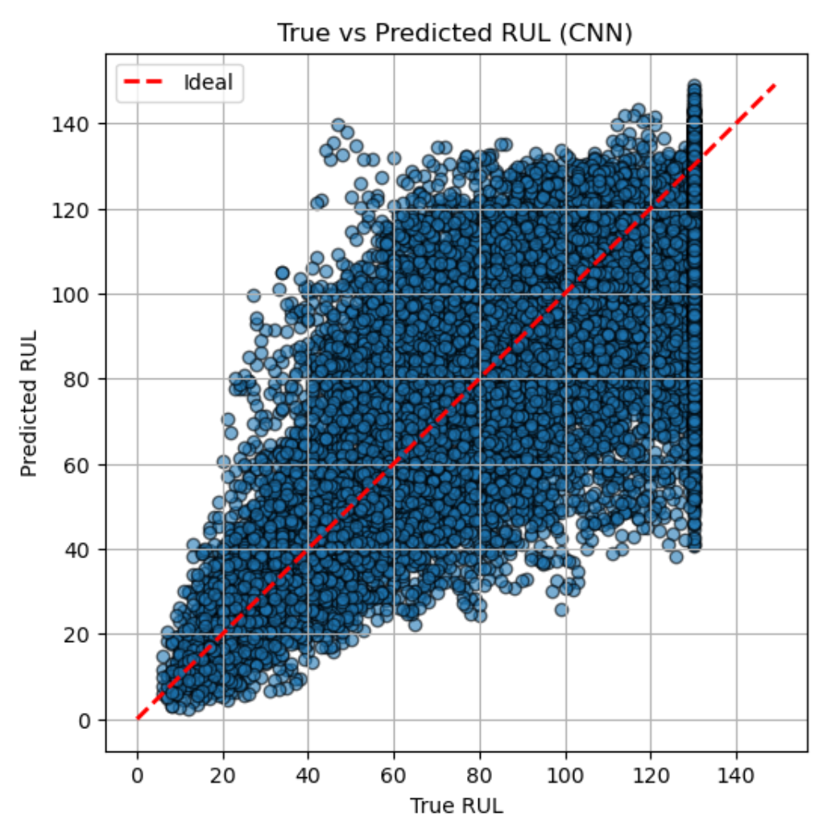
FD002 CNN Model: Calibration, Residuals, and Variability
Calibration Accuracy and Dispersion
CNN predictions align with true RUL trends at low values but show wider dispersion and over-prediction at higher RULs.
Residual Bias and Distribution
Residual plots show a negative bias with underestimation of RUL, favoring caution but risking premature maintenance.
Engine-Level Prediction Variability
Significant variability exists across engines, reflecting CNN struggles with regime shifts and generalization across conditions.
Short-Term vs Long-Term Performance
CNN performs well on short-term calibration but underestimates RUL at longer horizons, affecting fleet planning reliability.
Notes:
--- This slide references information from the following file: https://safrangroup-my.sharepoint.com/personal/mamadou_bah_safrangroup_com/_layouts/15/Doc.aspx?sourcedoc=%7B9F312128-DBF1-4C14-B43A-BA71190E981E%7D&file=Msc%20Project%20Report.docx&action=default&mobileredirect=true&DefaultItemOpen=1 The scatterplot shows that CNN predictions generally align with the true RUL trend, but with greater dispersion compared to FD001. At lower RUL values (<40 cycles), predictions are tight around the ideal line, which is encouraging for short-term maintenance alerts. However, at higher RULs the spread widens, with CNN tending to over-predict engine life. This is consistent with the challenge of disentangling degradation signals from condition-driven variability in FD002. Figure W: Calibration plot (True vs Pred, CNN FD002) Residual distributions & bias The residual violin plot confirms a systematic negative bias: many points lie below zero, meaning the CNN underestimates RUL (predicting failures earlier than reality). This conservatism is not necessarily problematic in aviation – it errs on the side of caution – but it does increase the risk of premature interventions. The long tails show occasional overestimates, indicating some engines are predicted to last far longer than they do. Figure X: Residual error distribution (CNN FD002) Per-engine variability The bar plot of sampled engines highlights substantial variability across units. For some engines, CNN tracks the true RUL closely, while for other predictions diverge sharply, particularly in mid-life cycles. This engine-to-engine inconsistency illustrates the difficulty CNNs face in handling regime shifts. The model captures local sensor patterns well but struggles to generalise degradation trends across different operating conditions. Figure Y: Per-engine error variability (CNN FD002) On FD002, the CNN shows solid short-term calibration but weaker performance at longer horizons, with a general tendency to underestimate RUL. While this cautious bias may be acceptable in safety-critical contexts, the engine-level variability reduces reliability for fleet-wide planning. This aligns with our earlier conclusion that LSTM-type models are better suited for multi-condition datasets, as they can model temporal dependencies more effectively than CNNs alone.

Slide 26
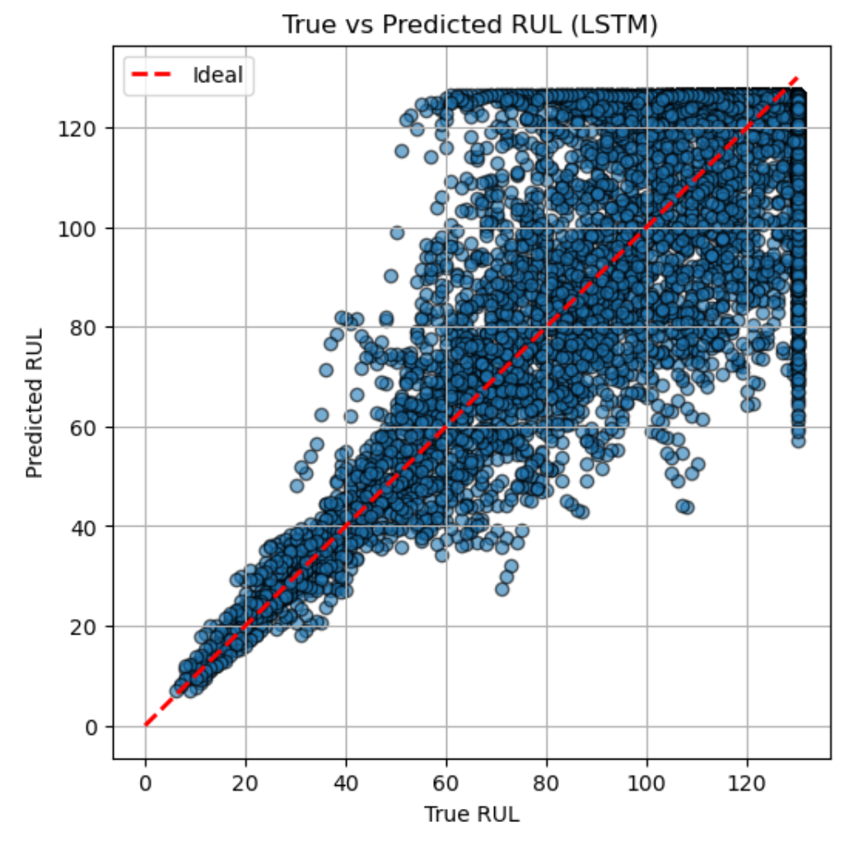
FD003 LSTM Model: Calibration, Residuals, and Variability
Model Calibration Accuracy
The LSTM model closely follows the ideal 45° line, showing accuracy across all RUL ranges and better calibration than previous datasets.
Residual Distribution and Bias
Residuals are centered around zero with a tight distribution, indicating the model is largely unbiased and balances over- and under-predictions.
Engine-Specific Prediction Consistency
Per-engine error variability is low as predicted values closely match actual lifespans, demonstrating the LSTM's ability to track individual degradation pathways.
Notes:
--- This slide references information from the following file: https://safrangroup-my.sharepoint.com/personal/mamadou_bah_safrangroup_com/_layouts/15/Doc.aspx?sourcedoc=%7B9F312128-DBF1-4C14-B43A-BA71190E981E%7D&file=Msc%20Project%20Report.docx&action=default&mobileredirect=true&DefaultItemOpen=1 The calibration scatter shows that the LSTM tracks the ideal 45° line very closely across the entire range of RUL values. At low RUL (<30 cycles), predictions are particularly accurate, which is critical since maintenance decisions are most sensitive here. In the mid-range (30–90 cycles), the model maintains tight clustering, although some spread begins to emerge as engines diverge in their dual-fault degradation patterns. At the upper end near the capped 130 cycles, predictions begin to saturate, reflecting both the dataset’s artificial cap and the model’s conservative bias not to over-predict excessively. Compared to FD001 and FD002, this calibration demonstrates clear improvement, highlighting the LSTM’s ability to capture long-term temporal dependencies under dual-fault stress. Figure Z: Calibration plot (True vs Pred, LSTM FD003) Residual distributions & bias The violin plot shows a compact distribution centred around zero, confirming that the LSTM is largely unbiased. Unlike the CNN on FD002, which skewed toward underestimation, the LSTM balances over- and under-predictions. Most residuals fall within ±20 cycles, a tighter spread than in earlier datasets. Occasional outliers reach ±60 cycles, but these are rare and likely linked to atypical sensor behaviour in engines with unusually long lifespans. The narrow waist of the violin indicates that for most cases, the LSTM provides predictions very close to the true values. Figure AA: Residual error distribution (LSTM FD003) Per-engine variability The bar chart of sampled engines demonstrates consistency: the orange (predicted) bars generally track very close to the blue (actual) bars, regardless of whether the engine failed early or ran beyond 300 cycles. This stability across different degradation pathways is particularly important in FD003, where the dual-fault setup could easily confuse weaker models. The LSTM’s temporal memory enables it to follow engine-specific progression without collapsing predictions to a generic mean trend. Figure AB: Per-engine error variability (LSTM FD003) On FD003, the LSTM shows its strongest performance so far. Calibration is tight across short, medium, and long horizons; residuals are centred and narrow; and engine-to-engine variability is well captured. This confirms that LSTM is the most suitable model for dual-fault, single-condition datasets: it can disentangle overlapping degradation signals while preserving accuracy across a broad range of lifespans. In practical PHM terms, the model delivers reliable early warnings with limited false alarms, providing planners confidence to schedule interventions without over-maintaining engines.

Slide 27
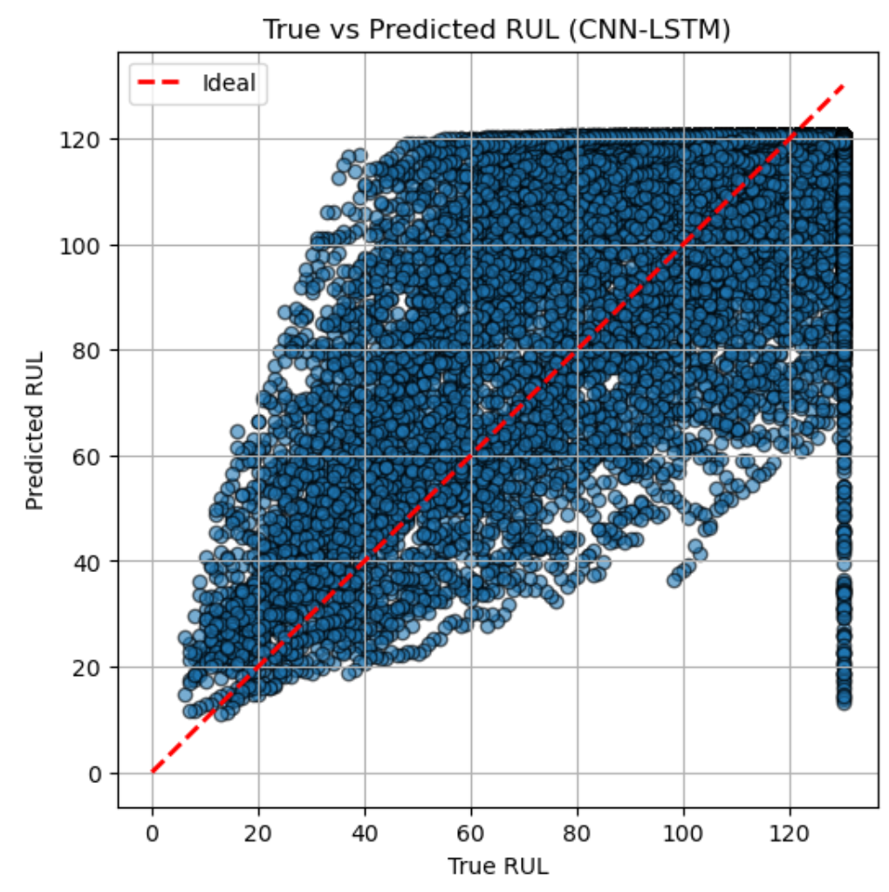
FD004 Hybrid Model: Calibration, Residuals, and Variability
Model Calibration Performance
The CNN–LSTM model approximates the ideal calibration line but shows more spread than previous models, especially at mid to high RUL values.
Residual Error Analysis
Residuals are mostly within ±20 cycles but have heavy tails with some large errors, indicating occasional under- and over-predictions.
Per-Engine Prediction Variability
Prediction accuracy varies across engines; some show close tracking, while others suffer sharp under-predictions under complex fault conditions.
Model Strengths and Challenges
The hybrid model balances local and temporal feature learning but struggles with extreme variability, yet offers conservative early warnings for maintenance.
Notes:
--- This slide references information from the following file: https://safrangroup-my.sharepoint.com/personal/mamadou_bah_safrangroup_com/_layouts/15/Doc.aspx?sourcedoc=%7B9F312128-DBF1-4C14-B43A-BA71190E981E%7D&file=Msc%20Project%20Report.docx&action=default&mobileredirect=true&DefaultItemOpen=1 The calibration scatter shows the CNN–LSTM following the ideal 45° line reasonably well, though with more spread compared to the LSTM on FD003. Predictions at low RUL values (below ~30 cycles) are fairly accurate, but at mid to high RUL, a wider dispersion is visible. Some points cluster around the 130-cycle cap, a sign that the model occasionally overestimates remaining life under complex dual-fault, multi-condition settings. Still, the CNN–LSTM tracks the general trend, suggesting it can learn both local and long-term degradation patterns but struggles with extreme variability. Figure AC: Calibration plot (True vs Pred, Hybrid FD004) Residual distributions & bias The residual plot shows a narrow concentration of predictions around zero, but with heavier tails than in FD003. This indicates occasional large errors both under- and over-predictions reflecting the difficulty of FD004. The bulk of residuals lie within ±20 cycles, which is operationally acceptable, but the presence of outliers reaching ±100 cycles is a weakness in reliability. Interestingly, the distribution’s centre sits slightly below zero, showing a small under-prediction bias (forecasting failures earlier than they occur). While conservative, this bias is not necessarily harmful in aviation, where early warnings are safer than late surprises. Figure AD: Residual error distribution (Hybrid FD004) Per-engine variability The sampled engine bar chart reveals mixed performance. For most engines, predicted RULs track the actual values closely, but in several cases, the model under-predicts heavily (e.g., engines with long lifespans are cut short in prediction). This reflects the challenge of FD004: engines degrade under both multiple conditions and dual failure modes, requiring the model to disentangle complex patterns. The hybrid’s CNN layers help capture local anomalies, while the LSTM handles temporal dependencies, but the interaction is not perfect leading to uneven accuracy across engines. Figure AE: Per-engine error variability (Hybrid FD004 On FD004, the CNN–LSTM delivers competent but less consistent results compared to the LSTM on FD003. Calibration is broadly aligned but more scattered, residuals are centred but fat-tailed, and per-engine performance is uneven with occasional sharp under-predictions. This highlights the difficulty of FD004 as the most complex dataset. Still, the hybrid demonstrates value: it remains competitive across both short- and long-term horizons, balancing CNN’s local pattern detection with LSTM’s temporal modelling. From a PHM perspective, its conservative under-prediction bias means planners receive early alerts, which, while imperfect, provide actionable buffers for maintenance scheduling in a high-stakes aviation setting.

Slide 28
Limitations, Threats to Validity, and Key Findings
Notes:
--- This slide references information from the following file: https://safrangroup-my.sharepoint.com/personal/mamadou_bah_safrangroup_com/_layouts/15/Doc.aspx?sourcedoc=%7B9F312128-DBF1-4C14-B43A-BA71190E981E%7D&file=Msc%20Project%20Report.docx&action=default&mobileredirect=true&DefaultItemOpen=1 Data, Methodological, and Model-Related Limitations, Evaluation and Generalisability Concerns, Summary of Key Findings and Practical Takeaways

Slide 29
Data, Methodological, and Model-Related Limitations
Dataset Limitations
The synthetic C-MAPSS dataset may not fully represent real-world engine behaviour due to controlled conditions.
Preprocessing and Training Constraints
Fixed preprocessing choices and limited hyperparameter tuning can bias models and limit exploration of optimal architectures.
Model Architecture Limitations
Chosen models have design trade-offs; simple baselines exaggerate performance gaps while complex hybrids risk suboptimal tuning.
Notes:
--- This slide references information from the following file: https://safrangroup-my.sharepoint.com/personal/mamadou_bah_safrangroup_com/_layouts/15/Doc.aspx?sourcedoc=%7B9F312128-DBF1-4C14-B43A-BA71190E981E%7D&file=Msc%20Project%20Report.docx&action=default&mobileredirect=true&DefaultItemOpen=1 The C-MAPSS dataset, while widely used, is a synthetic simulator rather than real-world engine data. This limits how representative the results are of actual fleet behaviour, where noise, maintenance history, and operating environments are more complex. Furthermore, the dataset only covers specific fault types and operating regimes, which narrows the scope of conclusions. Dropping flat sensors during preprocessing also carries risk: weak but potentially informative signals may have been discarded, reducing the models’ ability to capture subtle degradation indicators. The preprocessing and modelling pipeline involved fixed design choices, such as a 30-cycle sequence length, that may bias results toward certain temporal structures. Hyperparameters (epochs, batch size, learning rate) were tuned only lightly due to time constraints, meaning stronger architectures may not have been fully explored. Training relied on a single train/validation split, rather than repeated runs or cross-validation, which increases sensitivity to how the data happened to be partitioned. Early stopping was used to reduce overfitting but may also have limited model convergence. The models chosen baseline regression, CNN, LSTM, and CNN–LSTM reflect industry standards, but their specific implementations introduce limitations. The baseline regression is extremely simple, which may exaggerate the performance gap to deep learning models. The CNN–LSTM hybrid is highly sensitive to architectural design and may underperform if configured sub-optimally; other variants could achieve better results. Similarly, the choice of two-layer LSTM reflects a balance between complexity and training stability, but deeper or attention-based models might capture dependencies more effectively. Image source: Microsoft 365 content library

Slide 30
Evaluation and Generalisability Concerns
Limitations of Evaluation Metrics
RMSE and MAE treat early and late prediction errors equally, masking critical cost differences in PHM contexts.
Impact of Outliers and Averaging
Outliers skew RMSE, and averaging results hides per-engine variability crucial for fleet management.
Challenges in Generalising Findings
Real aviation fleets have complex data and operating conditions not captured by simulations, limiting direct generalisation.
Industrial Deployment Considerations
Deploying models like LSTM requires retraining with real data and integration with maintenance processes for reliability.
Notes:
--- This slide references information from the following file: https://safrangroup-my.sharepoint.com/personal/mamadou_bah_safrangroup_com/_layouts/15/Doc.aspx?sourcedoc=%7B9F312128-DBF1-4C14-B43A-BA71190E981E%7D&file=Msc%20Project%20Report.docx&action=default&mobileredirect=true&DefaultItemOpen=1 The study primarily used RMSE and MAE as evaluation metrics, which are standard but limited. Both treat early and late prediction errors equally, even though in PHM contexts late predictions are costlier than early ones. Outliers also play a large role in RMSE, so a small number of extreme errors may distort results. In addition, results were reported mainly as averages, which mask per-engine variability that is critical in fleet management. Including the PHM asymmetric scoring metric or reliability-based metrics would provide a more complete picture. The findings provide insight into relative model behaviour on C-MAPSS but generalising them to operational aviation requires caution. Real fleets involve messy sensor data, maintenance interventions, and irregular operating cycles that the simulator does not capture. While the LSTM proved most reliable here, deploying it in industry would require retraining with real fleet data, validation under varied conditions, and integration with existing maintenance decision processes. The results therefore should be interpreted as evidence of comparative performance under controlled conditions, not as guarantees of field performance. Image source: Microsoft 365 content library

Slide 31
Summary of Key Findings and Practical Takeaways
LSTM Model Performance
LSTM outperformed other models with the lowest error rates across multiple fault datasets, showing robustness in dual and multi-condition faults.
CNN Limitations
CNN models struggled with regime shifts and variability in operating conditions, demonstrating limits in convolutional approaches alone.
Hybrid CNN-LSTM Insights
The hybrid CNN-LSTM model showed competitive results but lacked the consistency of pure LSTM, highlighting sensitivity in hybrid architectures.
Practical Impact and Limitations
Model errors translate to operational buffers informing proactive maintenance; limitations include synthetic data and fixed design choices.
Notes:
--- This slide references information from the following file: https://safrangroup-my.sharepoint.com/personal/mamadou_bah_safrangroup_com/_layouts/15/Doc.aspx?sourcedoc=%7B9F312128-DBF1-4C14-B43A-BA71190E981E%7D&file=Msc%20Project%20Report.docx&action=default&mobileredirect=true&DefaultItemOpen=1 Summary of Key Findings · LSTM was the strongest performer across all four datasets, delivering the lowest RMSE/MAE, particularly on FD003 (dual faults) and FD004 (multi-condition + dual faults). · CNN struggled with regime shifts in FD002/FD004, confirming that convolution alone cannot fully capture operating-condition variability. · The hybrid CNN–LSTM was competitive on FD004, but showed less consistency than pure LSTM, underlining the sensitivity of hybrid designs. · Baseline regression consistently underperformed, highlighting the value of deep learning in modelling temporal degradation. · Diagnostics revealed systematic biases: CNNs tended to under-predict (safer but premature interventions), while the LSTM remained well-calibrated with narrow residuals and low engine-to-engine variability. · Practical implications: RMSE/MAE translate into 2–3 days of operational buffer, enough to inform inspections, spares procurement, and proactive scheduling. · Limitations acknowledged: synthetic data, fixed design choices, and limited hyperparameter tuning. Still, the comparative results provide robust evidence of relative model behaviour. Image source: Microsoft 365 content library

Slide 32
Conclusion
Deep Learning Potential
Deep learning techniques enable accurate predictions of engine Remaining Useful Life, enhancing maintenance schedules.
Digital Twin Integration
Digital twins simulate engine conditions in real time, improving prediction accuracy and operational insights.
Aviation Maintenance Benefits
Predictive maintenance enhances operational efficiency, reduces downtime, and lowers maintenance costs in aviation.
Notes:
In conclusion, this project demonstrates the potential of deep learning combined with digital twins to predict the Remaining Useful Life of engines, offering valuable benefits for aviation maintenance and operational efficiency.

